Slide 1
The last Sermon
As an Important Convention for Human Rights

Slide 2
Table of Contents
01
02
03
04
Introduction
Usury
Women rights
Slaves rights
05
06
Discrimination
Conclusion

Slide 3
01
introduction
An introduction to the last sermon of the holy prophet Hazrat Muhammad (peace be upon him)

Slide 4
introduction
was delivered on the Ninth day of Dhul-Hijjah, 10 A.H. ( 623AD) in the Uranah valley of Mount Arafat in Mecca

Slide 5
02
Usury
what is usury and why it is unethical in the religion?
Notes:
Aoa everyone, I am Luqman Ansari and I will talk about Ususry that has an important role in human rights. Riba is an Islamic word that comes from the word Raba, which means to grow and expand. Riba is also called Usury. It is defined as the action and practice of lending money at unreasonably high rates of interest. Prophet PBUH mentioned it in his farewell sermon, as he says
” Allah has forbidden you to take usury (interest); therefore, all interest obligations shall henceforth be waived. Your capital is yours to keep. You will neither inflict nor suffer any inequity. Allah has judged that there shall be no interest”

Slide 6
Usury
Quran
Hadith
“Whatever (debt) you lay out as usury, so that it may increase in the property of men, it will not increase for Allah. Whatever you give as charity, desiring Allah’s pleasure- it is those charity givers who will get manifold.”
“Here will certainly come a time for mankind when everyone will take reba and if he does not do so, its dust will reach him."
Notes:
This verse is from surah ruma, ayat number 39, that usury will increase the property of a person, anything spent from it in the way of ALLAH will not accepted, this shows the money obtained from usury is useless. Instead, only money earned in the halal way will get accepted.
In another, occasion Prophet PBUH said about usury that:
“Here will certainly come a time for mankind when everyone will take riba and if he does not do so, its dust will reach him”
Prophet PBUH had already predicted in the past, 1400 yrs ago that the curse of usury will reach us in the future, in one way or another.

Slide 7
Usury a poisonous killer
for any society
Inequality in Distribution of Wealth in society
Dis Harmony and disunity among Society Members
Increasing Hatredness between rich and poor
Increase in Corruption
Notes:
Usury has many negative impacts on the society:
1. Due to usury the rich continue to get richer, and poor continues to get poorer.
2. Social Ties are cut, and it causes dis harmony and and dis unity among society members.
3. Increase of hatedness between poor and the rich.
4. Increase of Corruption in society

Slide 8
03
women rights
what is the concept of women rights in Islam?

Slide 9
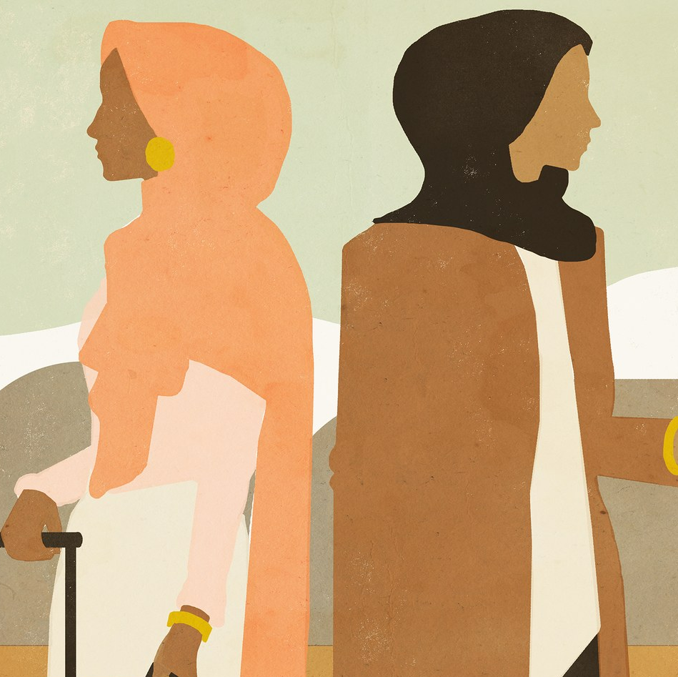
women rights
“ O people! Verily you have got Certain rights over your women and your women have certain rights over you. It is your right upon them to honor their conjugal rights, and not to commit acts of impropriety , which if they do , you are authorized by Allah to separate them from your beds and chastise them, but not severely, and if they refrain, then clothe and feed them properly.

Slide 10
04
slaves rights
how Islam treats with the slaves of their boss?

Slide 11
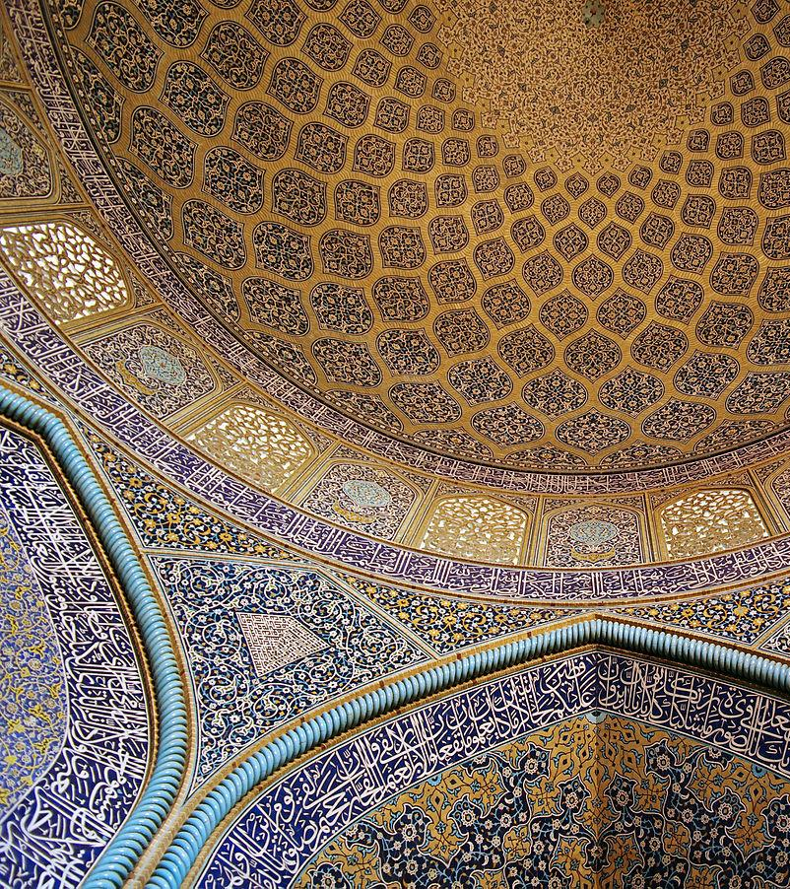
rights of slaves
Islamic rules on slaves are emancipatory in that they improve the rights of slaves compared to what was already practiced in the 7th century
Notes:
BEFORE ISLAM
DURING
SLAVES – ORIGIN – STATUS
LAGALITY

Slide 12
05
discrimination
what is discrimination?

Slide 13
—Hazrat Muhammad (PBUH)
discrimination
“All mankind is from Adam and Eve, no arab has any type of superiority over non-arab and nor non arab has superiority over arab, also white has no superiority over black nor black over white, except the piety and good actions ”

Slide 14
discrimination
Prevention from racial discrimination and colorism.
Respect every ethnicity.
The beautiful example of Bilal (R.A)
Convention in following in this charter.
Notes:
Usury has many negative impacts on the society:
1. Due to usury the rich continue to get richer, and poor continues to get poorer.
2. Social Ties are cut, and it causes dis harmony and and dis unity among society members.
3. Increase of hatedness between poor and the rich.
4. Increase of Corruption in society

Slide 15
94:4
“We have certainly created man in the best stature”

Slide 16
06
conclusion
human rights in the light of khutbah Hujja – tul - Widaa

Slide 17
Conclusions
descrimination
taq’wah
no one has any type of superiority upon other
taq’wah is only standard of superiority
huqooq ul Ibaad
strictness on the huqooq ul Ibaad

Slide 18
implementations
of sayings of the prophet

Slide 19
List of References
https://www.parhlo.com/10-important-articles-of-prophet-pbuhs-last-sermon-that-muslims-have-forgotten/
https://www.iium.edu.my/deed/articles/thelastsermon.html
https://www.daily-sun.com/post/251881/The-sermon-of-Hajjatul-Wida:-A-complete-charter-of-human-rights

Slide 20
Jazak Allah
do you have any questions?

